Slide 1

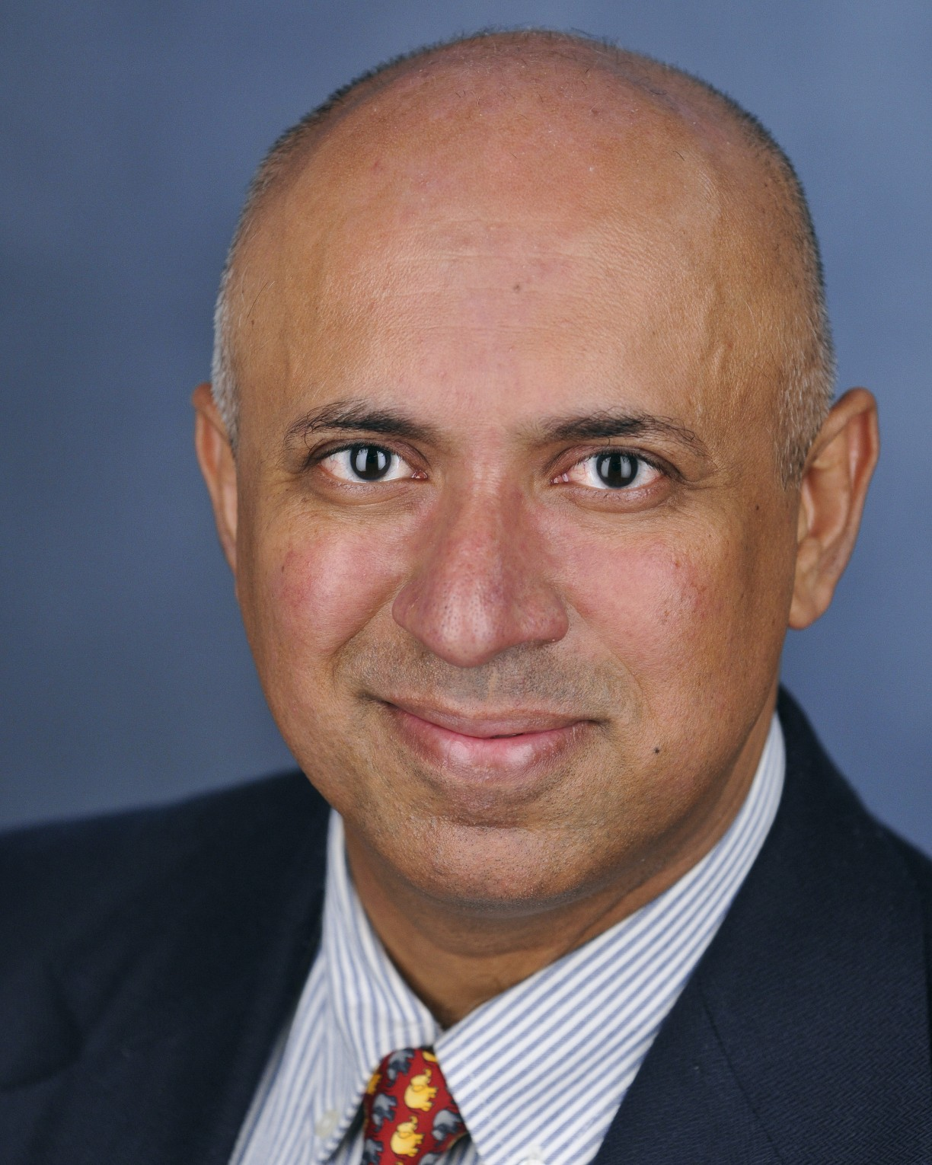
Seminar: Granular Micromechanics Explained
Join us for a Seminar by Dr. Anil Misra on Granular Micromechanics: Bridging Grain Interactions and Micromorphic Continuum Descriptions. All faculty members and students are cordially invited.
Location: EC 3665
Date: April 16th
Time: 11:25 AM - 12:25 PM
We look forward to your participation!
Anil Misra, Ph.D., P.E., F. AAAS, F. ASCE, F. EMI, F. AIMBE
Chair and Professor, Civil and Environmental Engineering Department

